Slide 1

Art Industry Contexts
at Mildura Arts Centre
This PowerPoint resource complements the VCE Studio Arts
Study Design – see also the accompanying Word document.
Studio Arts, Unit 4 Area of Study 3: Art industry contexts
Notes:
This education resource has been produced by Mildura Arts Centre for teachers to use in the classroom pre or post their Mildura Arts Centre gallery visit.
The reproduction and communication of this resource is permitted for educational purposes only.
HOW TO USE THIS RESOURCE:
Recommended to be used as a classroom presentation and discussion tool to support student learning.
Slide content is suitable for students.
Notes content is for teachers to expand upon concepts in slides.
Discussion questions are prompts for teachers to lead classroom conversations that further support students learning.
This PowerPoint has an accompanying Word document to test student’s knowledge for Studio Arts, Unit 4 Outcome 3.
INFORMATION ABOUT VISITING: milduraartscentre.com.au/Visit-us/Gallery.aspx
CURRENT EXHIBITION: milduraartscentre.com.au/Whats-On/Exhibitions.aspx
_____________________________________

Slide 2

Unit 3: Outcome 4
Compare the methods used by artists and considerations of curators in the preparation, presentation, conservation and promotion of specific artworks in at least two different exhibitions.
Notes:
This unit also investigates aspects of artists’ involvement in the art industry, focusing on a least two different exhibitions, that the student has visited in the current year of study with reference to specific artworks in those exhibitions. Students investigate the methods and considerations of the artist and/or curator involved in the preparation, presentation and conservation of artworks displayed in exhibitions in at least two different galleries or exhibitions.
The most important aspect of this outcome is that students visit two exhibition spaces in their current year of study and study specific artworks in each exhibition space.
Furthermore, students should try to visit different exhibition spaces such as public galleries, university art museums, commercial galleries, artist-run spaces and online exhibition spaces.
For example, compare exhibition(s) within Mildura Arts Centre, or; Rio Vista Historic House, or; Sculpture Park, or; exhibitions at the Art Vault (theartvault.com.au) / Mildura Riverfront Gallery (mildurariverfrontgallery.com.au/). The greater the contrast, the better the comparison.
_____________________________________

Slide 3

Gallery Types and Characteristics
Case study: Mildura Arts Centre
Notes:
Broadly speaking art galleries fall into the following categories:
Public Gallery
Private Gallery
Commercial Gallery
Artist-run-initiative (ARI)
Alternate and online spaces
_____________________________________

Slide 4

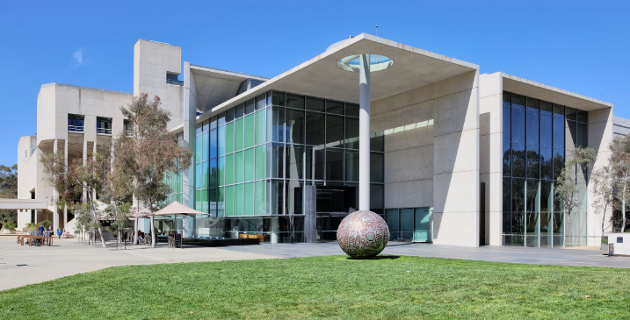
What is a Public Gallery?
Owned by or on behalf of the public.
Operates as a not-for-profit organisation.
Funded by government or philanthropic organisations.
Staffed with trained professionals.
Notes:
A Public Gallery is:
Owned by or on behalf of the public.
Main function is to research and preserve artworks, not to sell artworks .
An organisation whose goal is not to make a profit – any funding generated by example, through tickets or gift shop sales – then invested back into the organisation to fund operations.
Funding is often provided by government, local, state or federal government.
Funding is often provided by philanthropic organisations or trusts who invest in the arts for their social good – for example Ian Potter Foundation, and Naomi Milgrom Foundation
Able to hire staff with expertise as curators, collection managers, registrars, public programs and education programmers, marketing and communications staff.
Examples: National Gallery of Australia / Federal government funded, and National Gallery Victoria / State government funded
_____________________________
https://upload.wikimedia.org/wikipedia/commons/9/9a/National_Gallery_from_SW%2C_Canberra_Australia.jpg

Slide 5

What is a Private Gallery?
Display or collection of artworks owned by a private person or organisation.
Made available for the public to enjoy.
Artworks often selected and managed by a curator.
Notes:
A Private Gallery:
Is an organisation whose goal is not to make a profit from the display of artworks.
Supports artists by collecting their works.
Often employs a curator who is involved in the selection of works.
A curator or collection manager may oversee the management, proper storage and display of a artworks.
Example: JAHM (Justin Art House Museum) [jahm.com.au]
______________________________
Image credit: https://www.jahm.com.au/new-page

Slide 6
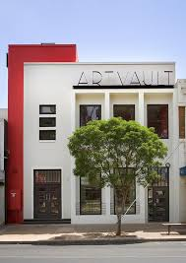
What is a Commercial Gallery?
Gallery that generates a revenue or is a for-profit space.
Funded by the sale of artworks, or the hire of display spaces.
Have contracted artists they represent and promote in return for retaining a percentage of artwork sales.
Notes:
3. A commercial gallery
An organization whose goal is to make a profit
Represent and promote select contracted artists.
Revenue is generated through sales of artworks – taking a percentage of the sales from the artworks.
Some commercial galleries make an income by renting the gallery spaces to artists.
Not likely to be eligible for grant or philanthropic funding.
Example: The Art Vault, Mildura (theartvault.com.au)
______________________________
Image credit: Exterior of The Art Vault.
https://www.facebook.com/The-Art-Vault-184553564920756/

Slide 7
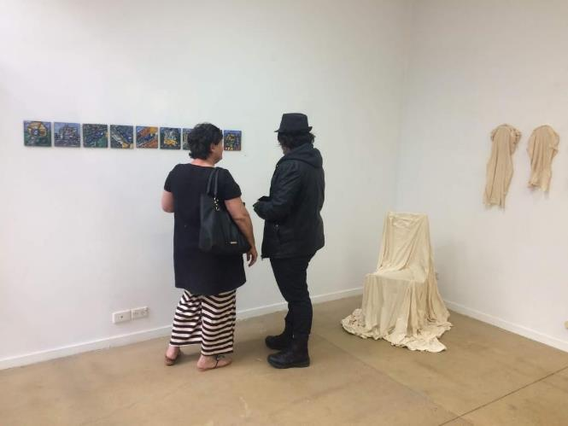
What is an Artist-run Initiative (ARI)?
Often run by artists themselves straight out of university.
Operates as a grassroots or not-for-profit organisation
Self-funded by artists or grant funding recipients.
Notes:
Artist-run initiatives:
Are primarily for the promotion of artists and artworks.
Are founded by artists, without an expectation artworks will sell, and may be self-funded.
Give artists control over how their work is displayed.
Are organisations whose goal is not to make a profit and are managed by a committee (usually volunteers).
Seek funding via grants by local government, state or federal government, and philanthropic organisations.
Examples;
Mildura Gallery F, “is an exhibition and workshop space run by artists for artists.” [http://galleryfmildura.blogspot.com/]
MIM: Museum of Innocence Mildura, which is run by Arts Mildura. [http://http://museumofinnocencemildura.org/]
_________________________________
Image credit: Emergence (installation view), SuniTAFE and La Trobe University combined student exhibition, Gallery F Mildura. http://galleryfmildura.blogspot.com/

Slide 8

What are Alternate and Online Spaces?
Alternate spaces include cafes’, murals in public spaces and art fairs.
Virtual or online galleries are digital websites and applications whereby the work displayed is primarily digital.
Notes:
Online and Alternate Spaces:
Alternate spaces include cafes’, murals in public places, and art fairs.
Online galleries display digital artworks. They are not virtual displays of paintings, drawing, prints, or sculptures.
Examples,
Cafés: Steampunk and Clove Organics in Mildura.
Mural: ‘Mildura’, Ninth Street designed by Travis Price, painted by signwriter Terry ‘Moose’ McGowan https://www.milduracity.com.au/community-art/ninth-street
Virtual/digital museum: Espacio Byte, Digital Art Museum http://www.espaciobyte.org/the-museum
_________________________________
Image credit: ‘Mildura’, Ninth Street designed by Travis Price, painted by signwriter Terry ‘Moose’ McGowan https://www.milduracity.com.au/community-art/ninth-street

Slide 9
Case Study: Mildura Arts Centre
Owned by local government entity Mildura Rural City Council.
Creative Victoria (state government) also provides some funds.
Maintains a collection of artworks for community benefit.
Has exhibition spaces and art storage facilities that are designed and built according to world standards set for galleries and museums. Standards maintain the environmental conditions that ensure artworks last well into the future.
Consists of indoor and outdoor exhibition spaces for the display of artworks, as well as events and festivals.
Notes:
Mildura Rural City Council owns Mildura Arts Centre, and together with financial support from the state government (through Creative Victoria) funds the exhibition programs, staffing and marketing of activities or programs at Mildura Arts Centre.
Mildura Arts Centre has a collection of artworks that is cared for and displayed according to international museum standards.
Museum quality standards are adhered to that ensure consistency across all art museums and galleries. Standards are set by the International Council of Museums (ICOM). This becomes important when art galleries loan artworks from other galleries and cultural institutions.
Increasingly venues like Mildura Arts Centre are attempting to become financially viable and generate their own income through sales of paid tickets to select programs, retail (gift shop) and café sales.
Mildura Arts Centre consists of indoor and outdoor exhibition spaces for the display and care of art.
DISCUSSION: Where does Mildura Rural City Council gain an income from?

Slide 10
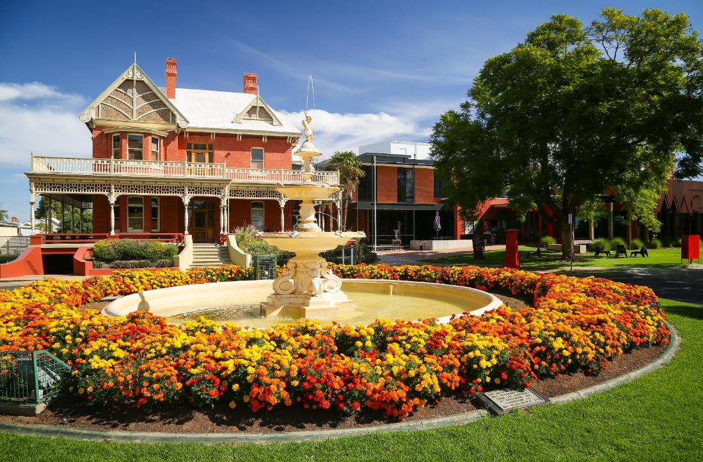
Notes:
Mildura Arts Centre consists of a group of buildings and gardens that is dedicated for use as a visual, cultural and performing arts precinct.
Mildura Rural City Council’s purchase of Rio Vista Historic House in 1950 was the first step in realising the goal for a cultural precinct.
Rio Vista first opened to the public in 1956 to display artworks bequeathed to Council by Senator R D Elliott in 1944, and his wife Hilda Elliott in 1970.
_____________________________________
Image credit: Mildura Arts Centre exterior, 2016.

Slide 11
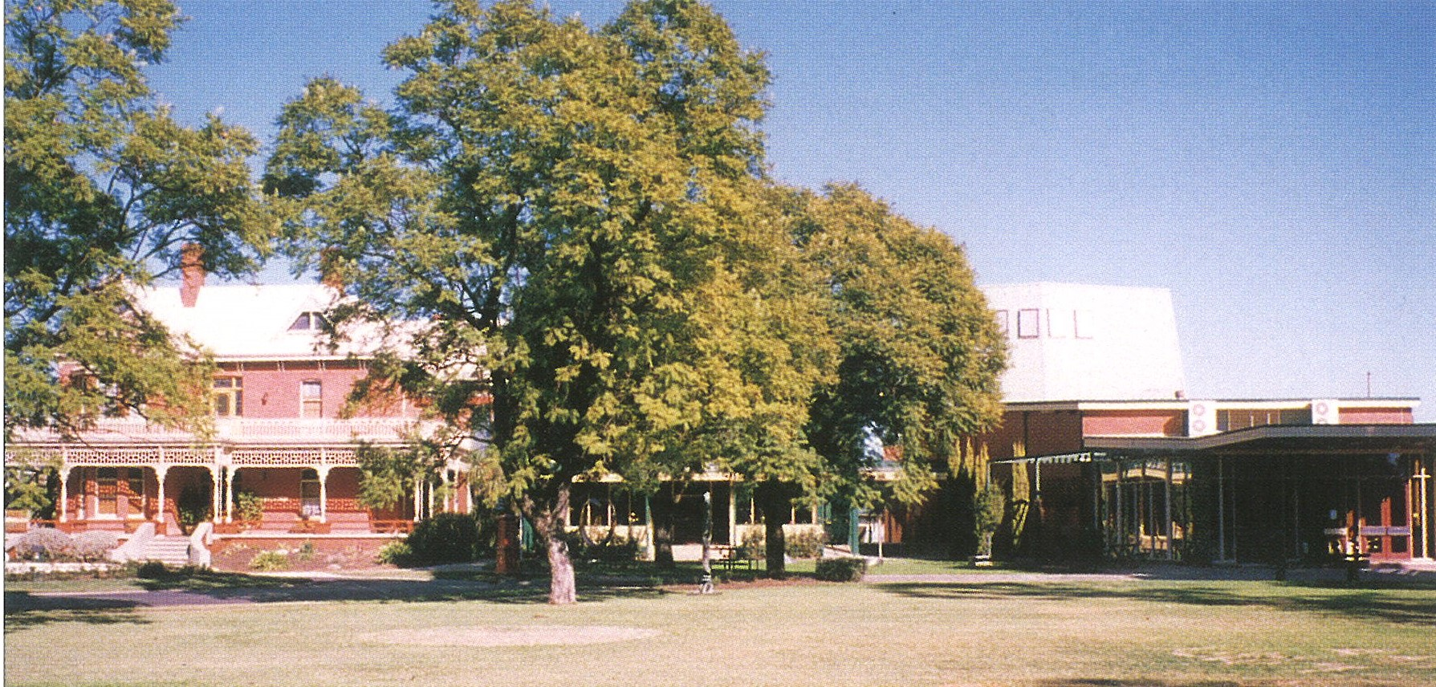
Notes:
With an addition of a purpose-built art gallery beside Rio Vista and performing arts theatre space in 1966 - it was renamed Mildura Regional Arts Centre.
_____________________________________
Image credit: Exterior of Mildura Arts Centre c. 1980s. Mildura Arts Centre archives.

Slide 12
Notes:
In 2012 a state of the art performing arts venue connected the theatre to the art gallery and Rio Vista Historic House.
_____________________________________
Image credit: Architect’s impression of the North Elevation of the new theatre – Williams Boag Architects.

Slide 13
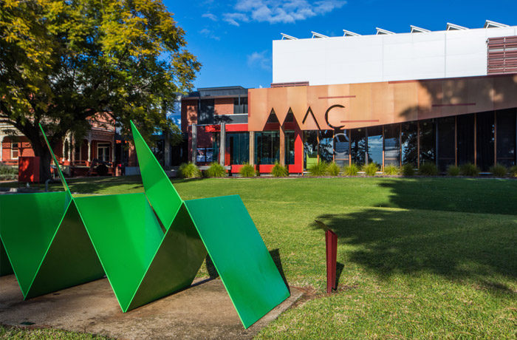
Notes:
The precinct known as Mildura Arts Centre and the entire site, plays a crucial role in collecting, preserving and presenting art exhibitions, cultural heritage, performances and festivals for the people of Mildura and visitors to enjoy.
____________________________
Image credit: View of Mildura Arts Centre from front lawns.
Artwork credit: foreground: Ron Robertson-Swan, Beethoven, 1968. Painted steel. Mildura Arts Centre Collection.

Slide 14
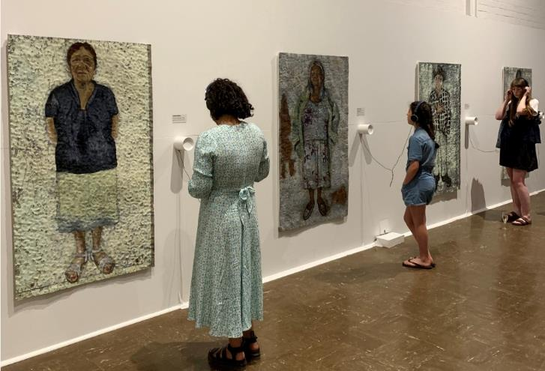
What type of gallery is Mildura Arts Centre?
Public gallery
Private gallery
Commercial gallery
Artist-run initiative (ARI)
Alternate or online gallery
Notes:
DISCUSSION:
Does Mildura Arts Centre:
Sell artwork? [Yes, for specific exhibitions and to offer artists opportunities to earn an income from their arts practice.]
Accept funding from government or philanthropic organisations? [Yes]
Hire out exhibition spaces for a fee? [No]
Have a volunteer committee involved in the day to day running? [No]
Have professional staff with expertise in specific areas relating to working in a gallery? [Yes]
What type of gallery is Mildura Arts Centre?
_____________________________________
Image credit: Barka: The Forgotten River‘: a collaborative exhibition by Badger Bates, Justine Muller and the Wilcannia community. Installation view of Justine Muller portraits, exhibition opening and floor talk event, 5 December 2019, Mildura Arts Centre lower galleries.

Slide 15
Curatorial Considerations in Exhibition Planning
Case study: Mildura Arts Centre
Notes:
Curators and the teams they work with make lots of choices around how people experience an exhibition. These choices are considered and have constraints.
Importantly, the curator thinks about the display in terms of how their decisions can help to tell a story about an art theme, or artist.
_____________________________________

Slide 16
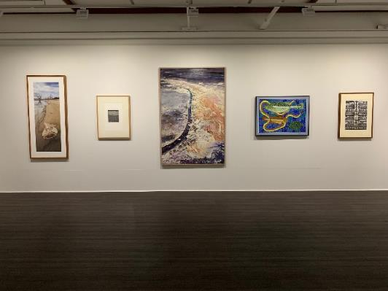
What is the role of the Curator at MAC?
A curator’s responsibilities may include:
Selection of artists and/or artworks.
Conducting research on artworks and artists.
Write interpretive materials etc.
Determine the presentation, look and feel of exhibitions.
Liaise with conservators to manage the maintenance and restoration of artworks.
Notes:
A curator role is that of the caretaker within an art gallery or museum.
They are responsible for the selection of artists and artworks to be included in an exhibition or within a collection.
Curators conduct research into artists and artworks to help them make decisions about including works.
Curators write didactic panels (wall texts), exhibition brochures, catalogue essays, work with the marketing and communications team to provide information that can promote an exhibition. Then when the exhibition is open curators conduct floor talks to present information to the public to enable people in the interpretation of exhibitions.
Curators determine how an exhibition presentation will look and feel. Everything from how artworks are displayed, to colours of walls and how an exhibition’s artworks are placed in relation to other works around it.
Curators manage the care, transport and appropriate storage of artworks. They liaise with conservators when artworks need to undergo conservation works.
In larger galleries, some of these tasks are shared between registrars, collection or exhibition managers.
At Mildura Arts Centre staff titles are:
Gallery and Heritage Team Leader
Registrar and Collections Officer
Gallery Programs Officer
_______________________________
Image credit: Land, Place and Country: Mildura Arts Centre Collection (installation view), 2016. Mildura Arts Centre upper galleries.

Slide 17
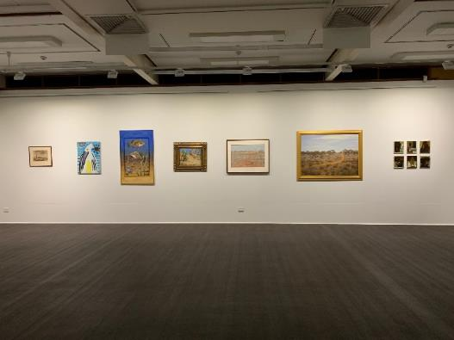
What are Curatorial Considerations at MAC?
Exhibitions are inspired by:
The art collection.
Invited visiting artists.
Local community artists.
Touring exhibitions.
Themes and ideas relevant to the local community.
Notes:
Mildura Arts Centre has five exhibition spaces (or galleries) showcasing a vibrant mix of temporary exhibitions.
The exhibition program is inspired by:
Works in the Mildura Arts Centre Collection (to learn more about the Collection see milduraartscentre.com.au/Visit-us/MILDURA-ARTS-CENTRE-COLLECTION.aspx)
Contemporary emerging and professional artists (visiting artists) and curators invited to exhibit.
Local community artists.
Touring exhibitions .
Ideas in art that are relevant to ideas emerging within the local community.
Artists and curators wanting to exhibit at Mildura Arts Centre can submit an exhibition proposal form. The application is assessed according to how it relates to the Mildura Arts Centre Exhibitions policy.
These things are overseen by a curator.
_____________________________________
Image credit: Land, Place and Country: Mildura Arts Centre Collection (installation view), 2016. Mildura Arts Centre upper galleries.

Slide 18
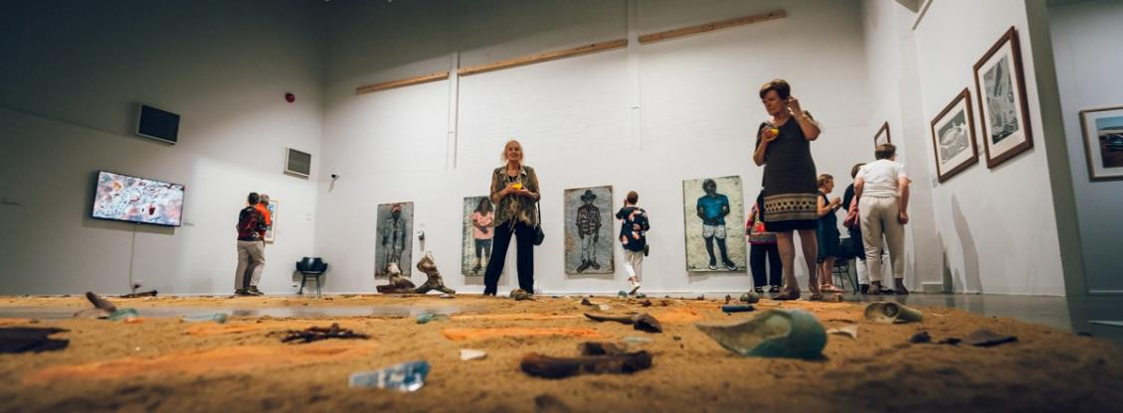
What are Curatorial Considerations at MAC?
Exhibitions are planned one to three years ahead.
Notes:
Exhibitions are scheduled one to three years in advance and are planned to ensure a balance between the previous criteria. This also allows time for the curator to conduct research relevant to the exhibition theme.
This also allows time for loans from other organisations, artists and art collectors.
Exhibitions are usually on display for about three months and the galleries are closed for about one week to allow for exhibition changeover.
Whenever possible the curator will work with the artist to ensure artworks are displayed at their best. (If the artist is not able to travel to Mildura, some forward planning with the artist or exhibition organiser takes place prior to install.)
_____________________________________
Image credit: Barka: The Forgotten River: a collaborative exhibition by Badger Bates, Justine Muller and the Wilcannia community (installation view), exhibition opening and floor talk event, 5 December 2019, Mildura Arts Centre lower galleries.

Slide 19
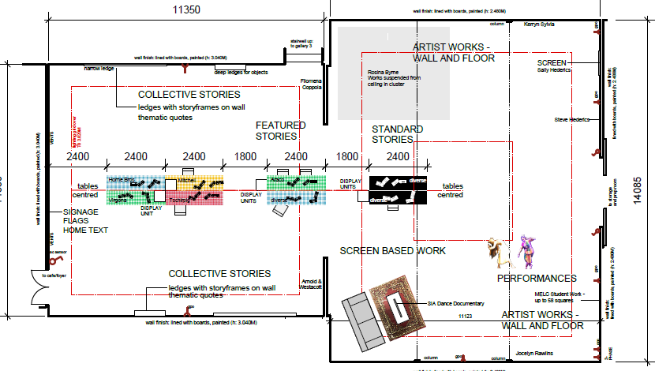
What are Curatorial Considerations at MAC?
Notes:
Some curators work with miniature models of galleries, others with virtual galleries using digital programs.
At Mildura Arts Centre the curator works with architectural drawings. This is important as the curator needs to communicate with exhibition installers who will physically layout the artworks according to the plans.
This floorplan shows the anticipated layout of an exhibition Making Home: Mildura Migration Stories.
The gallery space to the left; was set up with tables, reminiscent of a domestic (household) setting with photo frames, books, stories and personal objects, and museum display cases.
The gallery space to the right; showcased the work of various artists, utilising a range of display and installation methods.
See the next slide shows what the exhibitions finally looked like.
_____________________________________
Image credit: Making Home: Mildura Migration Stories exhibition design © Sven Mehzoud, 2019.

Slide 20
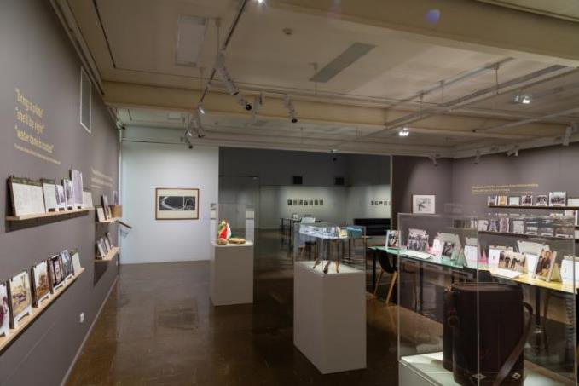
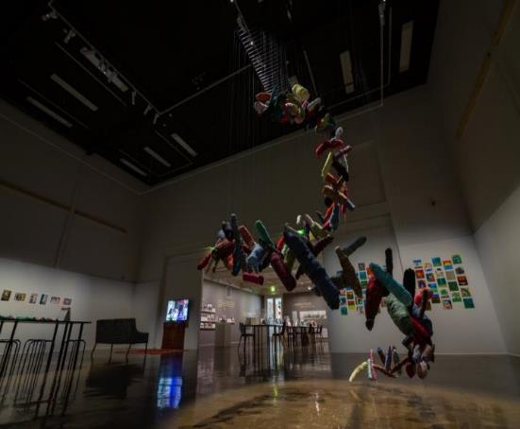
What are Curatorial Considerations at MAC?
Notes:
These photographs show the final layout of the exhibition, Making Home: Mildura Migration Stories.
The gallery space to the left; was set up with tables, reminiscent of a domestic (or household) setting with photo frames, books, stories and personal objects, as well as museum display cases.
The gallery space to the right; showcased the work of various artists, utilising a range of display and installation methods.
See the previous slide for what the exhibitions were anticipated to look like.
DISCUSSION: Name some display methods that have been utilized in this exhibition, or makes it look different to other exhibition displays. (Including wall colours, different hanging methods, works displayed on wall shelves, artworks in display cases, the way lights have been used to light artworks in a specific way and/or create a mood or atmosphere, vinyl text applied to the walls.)
_____________________________________
Image credit: Making Home: Mildura Migration Stories (installation view), 2019, Mildura Arts Centre lower galleries.

Slide 21
Summary: Curatorial Considerations at MAC
Overarching story the exhibition is telling.
Wall colours and lighting.
Artist preferences.
Practicalities: placement of artworks (for example, require power, and wall weight baring capacity).
Accessibility and OH&S.
Budget.
Notes:
In summary, these are the main concerns and questions for the curator at Mildura Arts Centre:
What exhibition layout and type of hang best going to tell the main story? For example: Are there themes? Is it a chronological display?
What wall colours and lighting best enhance the artworks or are a requirement of standards?
What input does the artist want to have in these decisions? How will the curator work with the artist?
What practical things will influence where and how artworks are displayed? Is power accessible? Can a wall or floor hold a weight? Is there a heritage requirement? For example, in Rio Vista hanging is restricted to a hanging system and walls cannot be painted different colours.
The curator needs to ensure the space complies with Occupational Health and Safety requirements? Are emergency exits still accessible? Is it accessible to people with disabilities? Can a wheelchair (or pram) fit through the displays? Are wall labels placed at the optimum height?
How much money does the curator have to spend on an exhibition and therefore transform the look of a space?
_________________________________
Image credit: National Portrait Gallery of Australia, Starstruck: On Location (installation view), October 2019. Gallery 5 (Rio Vista Historic House).

Slide 22
Conservation:
Preventative and Remedial
Case study: Mildura Arts Centre
Notes:
There are two types of conservation.
Preventative – measures taken to prevent damage from occurring
Remedial – steps taken to restore an artwork to as close to its original look as possible
_____________________________________

Slide 23
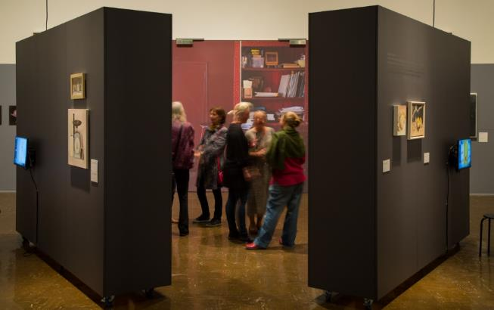
Why do we need to protect artworks?
It is the role of galleries and museums to act as custodians for the artworks and objects in their collections and exhibitions.
Thereby allowing the general public access for their education and entertainment, plus ensure artworks last for future generations to enjoy.
Notes:
Galleries and museums worldwide are responsible for the care and preservation of an immense variety of (often irreplaceable) artworks, objects, and artefacts in order to ensure their preservation for the education and entertainment of people today and future generations to come.
Artworks and objects held in the Mildura Arts Centre collection include paintings, prints, drawings, sculptures, ceramics, textiles, decorative arts, and new media. The materials used to create these artworks are extremely diverse and each requires particular care.
Remember, there are international standards of care exists that outlines the optimum conditions for the preservation of artworks or objects in a gallery’s collection.
_____________________________________
Image credit: Anjelie Beyer: Impossible Things and selected verse (installation view) Exhibition opening 6 December 2017. Mildura Arts Centre lower galleries.

Slide 24
Conservation types
Preventative
Remedial / Restorative
Display strategies
Lighting
Temperature
Humidity
Pest management
Dust
Manual handling
Storage
Transportation
When an artwork is damaged and needs to be restored to appear more like its original state.
Curators liaise with specialist conservators for this kind of work.
Notes:
Conservation falls into two categories. Preventative and remedial.
Preventative conservation are strategies a curator applies to the display of an artwork to minimise damage occurring. These include:
Using plinths and cases to contain works, barriers to prevent people getting too close or touching,
Making sure bright lights don’t damage fragile art materials.
Ensure the temperature is consistent within the gallery.
Ensure pests – like insects - don’t have access to artworks.
Protect artworks from damage while being handled by exhibition installers.
Ensure collection artworks are kept in suitable storage spaces when not on display.
Secure artworks for storage or transportation in specially made cases.
Security guards (invigilators) supervising people’s interactions with artworks.
Remedial (or restorative) conservation is when an artwork is damaged and needs to be taken to a conservator to repair it or ensure further damage does not occur (stabilise).
DISCUSSION: Brainstorm some ways artworks can be damaged in galleries. What could a curator reasonably do to ensure that this does not happen.
_____________________________________

Slide 25
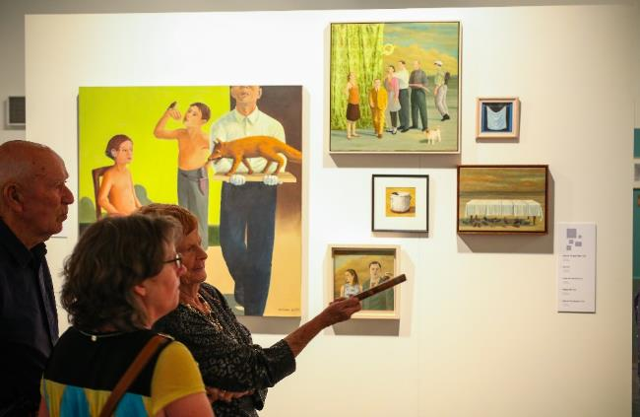
Preventative Conservation: People
Display cases made of Perspex.
Plinths and barriers around artworks.
Security staff and invigilators.
Signage ‘do not touch the artworks’
Rules asking visitors don’t bring food or drink in galleries.
Notes:
There are things galleries and curators can do to help prevent people from damaging artworks while they are on display in the galleries.
Use display cases, so people cannot touch artworks.
Use floor plinths, floor tapes and/or barriers around artworks that prevent people getting too close to artworks.
Have security people or invigilators in the galleries to talk to people about the artworks and prevent them from touching.
Display signage that says, “do not touch”.
Have ‘conditions of entry’ whereby people cannot bring food or drink into the gallery, that could potentially spill on an artwork. This may also include; no pens, (only pencils), no large bags, backpacks or umbrellas.
_____________________________________
Image credit: Graeme Drendel: Silos + Silence (installation view), exhibition opening event December 2016. Mildura Arts Centre lower galleries.

Slide 26
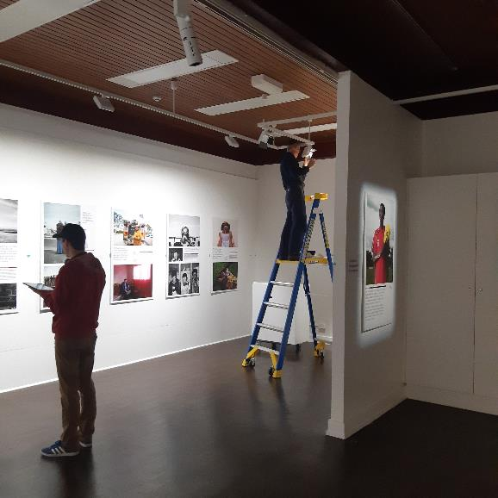
Preventative Conservation: Lighting
Notes:
Galleries are careful to ensure lighting is set to a level that will ensure the least amount of damage to artworks.
Artworks exposed to strong or bright lighting such as daylight can affect them. Photographs and works on paper can deteriorate, fade, turn yellow and the paper become brittle. Works on paper are also rested when not on display in special cases called Solander boxes whereby the artworks are protected from damage occurring while in storage.
When photographic and other works on paper are displayed at Mildura Arts Centre the LED gallery grade lights are dimmed to help protect the artworks.
_____________________________________
Image credit: Mildura Arts Centre tech team positioning lights and adjusting light levels,
Exhibition credit: MAP Group (Many Australian Photographers), Beyond Borders (installation view) June 2019. Mildura Arts Centre Gallery 4.

Slide 27
Preventative Conservation: Lighting
Lux is the measurement of light.
A light meter is used to measure lux:
10,000 lux equivalent to daylight – outdoor sculptures
400 to 500 lux – metal and wood
200 to 300 lux – oil paintings
50 lux – fragile works on paper
10 lux – fabric
Notes:
Museum standards for the recommended lighting or lux levels have been set according to the type of artwork.
On average daylight measures 10,000 lux – and is acceptable for outdoor sculptures.
400 to 500 lux – is generally acceptable for artworks made of metal and wood.
200 to 300 lux – is acceptable for oil paintings.
50 lux – is a low level to protect fragile works on paper.
10 lux – is the lowest light level to reduce damage to fabrics and materials.
You may notice that in the galleries there are few windows, or that they are carefully placed so that as little daylight as possible can reach the artworks. Windows might also have blinds or tints applied to reduce ultraviolet light rays from causing damage.
DISCUSSION: What lux level is preferred for a wooden stool with a tapestry padded seat?
_____________________________________

Slide 28
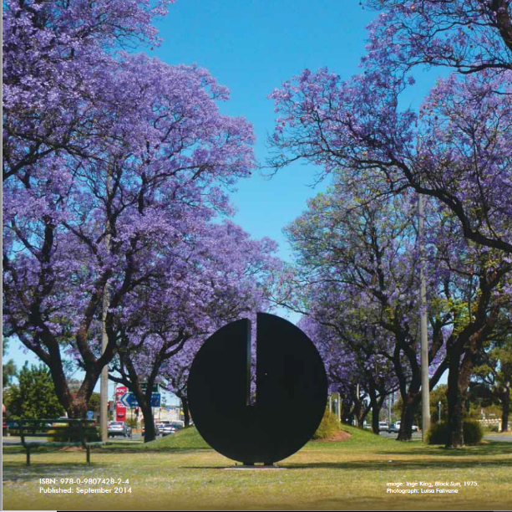
Preventative Conservation: Lighting
Notes:
Artworks on display out-of-doors have very specific requirements.
They must be made of durable materials, so the weather (for example, rain or bright sunlight) will not impact them.
Security is also an issue in open public space, so artworks need to have secure footings.
_____________________________________
Image credit: Inge King, Black Sun, 1975, Painted steel. 239 X 208 x 72 mm. Mildura Arts Centre Collection
Location: between Eleventh and Twelfth Streets, Deakin Avenue, Mildura.
Photo credit: Luisa Falivene

Slide 29
Preventative Conservation: Climate Control
Temperature
Relative Humidity
Mildura Arts Centre’s gallery climate control system is set to 20-21 degrees Celsius.
This ensures art works are not affected by the temperature within the space.
Mildura Arts Centre’s climate control is set to 50%.
Mould starts to grow at 68%.
Notes:
Temperature and humidity changes can affect the structure of objects, making it important to keep artworks at a consistent levels. For example expansion and buckling of materials and supports can occur. Materials like paint can shrink and crack. If Relative Humidity levels rise, conditions become attractive to insects and mould can grow.
As groups of people enter or leave the exhibition, and the doors open and close, shifts in temperature and humidity occur. A sophisticated climate control system ensures consistent temperature and humidity levels.
A constant temperature is best and the ideal level is 18–22 degrees Celsius.
The ideal level for Relative Humidity is 50%. Mould starts to grow at 68%.
_____________________________________

Slide 30
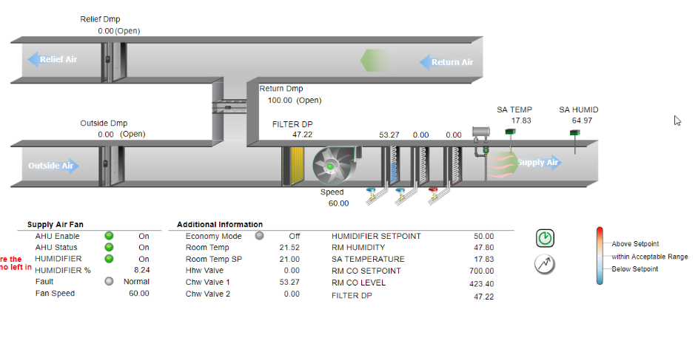

Preventative Conservation: Climate Control
Notes:
Temperature and Relative Humidity is measured by a thermo-hygrograph or hygrothermograph, which registers the temperature and relative humidity levels in a gallery.
On the left is a temperature data logger, that captures this information in the galleries.
On the right, this picture shows environmental conditions at Mildura Arts Centre at a specific moment in time. These are monitored via an online computerised building management system.
An art gallery that is going to loan a valuable artwork to Mildura Art Gallery may want to see this, as evidence Mildura Art Centre can care for the artwork according to the international standards for the care of artworks.
_____________________________________
Image credit: Temperature data logger in gallery. Screenshots of the Building Management System: Heating, Ventilation, and Air Conditioning computer interface.

Slide 31
Preventative Conservation: Environmental
Pest management
Dust
Pests are carefully controlled in a gallery environment as an infestation can do a lot of damage to artworks.
Artworks in the collection and on display need to be carefully monitored.
The curator creates a schedule to ensure works on display and in the collection are dust free.
Dust and dirt collecting in artworks can cause damage in the longer term, that may require conservation treatment in the future.
Notes:
Staff at the Mildura Arts Centre need to ensure artworks are kept insect and dust free.
A pest controller regularly visits to ensure insects, such as moths and silverfish do not infest or damage artworks.
The curator must ensure that artworks are kept clean while they are on display and in storage, by creating a cleaning schedule. This cleaning is completed by trained gallery staff who work at Mildura Arts Centre.
_____________________________________

Slide 32
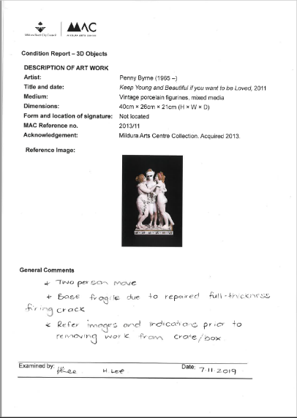
Preventative Conservation: Condition Reports
DESCRIPTION OF ARTWORK
Artist/maker:
Title/Date:
Medium:
Dimensions (height x width x depth):
Form and location of signature:
MAC reference number:
Acknowledgement:
Reference Image:
General Comments
Examined by:
Date
Notes:
Condition reports are completed to document any changes in the artwork that have occurred over time.
These are detailed documents that show an artwork has been inspected carefully and regularly to ensure there are no changes in an artwork. This method allows for early detection of something being wrong with an artwork.
Condition reports for loaned artworks are completed:
Before an artwork is transported.
When an artwork arrives at the gallery.
During the exhibition period.
Before it is packed for transport.
On arrival at the artwork lenders destination.
Artworks in collections are inspected and a Condition report completed at regular intervals.
_____________________________________
Image credit: Example of Mildura Arts Centre Condition Report for 3D Objects.
Artwork credit: Penny Byrne, Keep Young and Beautiful if you want to be Loved, 2011. Vintage porcelain figurines, mixed media. Mildura Arts Centre Collection. Acquired 2013.

Slide 33
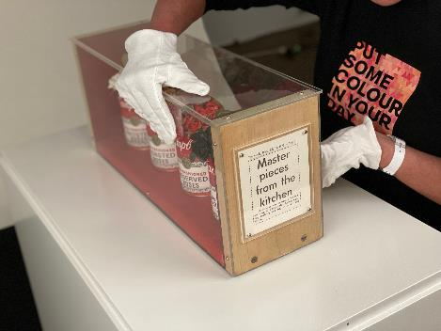
Preventative Conservation: Manual Handling
Exhibition installers use manual handling procedures in line with museum standards.
Wear gloves to prevent damage from oils and acids in skin.
Make sure lanyards or jewellery doesn’t damage artworks.
When possible, equipment is used to move artworks, rather than it being carried.
Place artworks on foam blocks or carpet squares while the room arrangement or hang is being finalised.
Notes:
When artworks are moved between storage and gallery spaces, they are vulnerable to damage occurring through mishandling.
Specialist art handlers and installers are people who have undergone the training to know museum standards for the safe handling of artworks. Installers:
Wear gloves, to prevent leaving fingermarks from oils and acids in the skin and ensure good grip of artworks.
Make sure lanyards, jewellery and watches are well hidden or not worn, to avoid scratches.
Whenever possible artworks are either carried by two art handlers, or moved with trolleys, so artworks are not dropped.
While artworks are being arranged in the gallery, works go on foam blocks or carpet squares, rather than the floor, to ensure no damage to the edges of the artwork occurs. Works on paper are laid on tables to keep them flat prior to install.
Installers follow the curator’s plan to put everything in its correct place.
The installers are also tasked with de-installing the exhibition when it is over.
Then to prepare for the next exhibition, the walls and display plinths may need to be patched and painted.
_____________________________________
Image credit: Mildura Arts Centre exhibition team member handling artwork.
Artwork credit: Isabel Davies (1929- ), Kitchen Creation, 1977. Wood, perspex, cloth, tin cans, can opener. 22.5 x 55. 5 x16.5 cm. Mildura Arts Centre Collection.

Slide 34
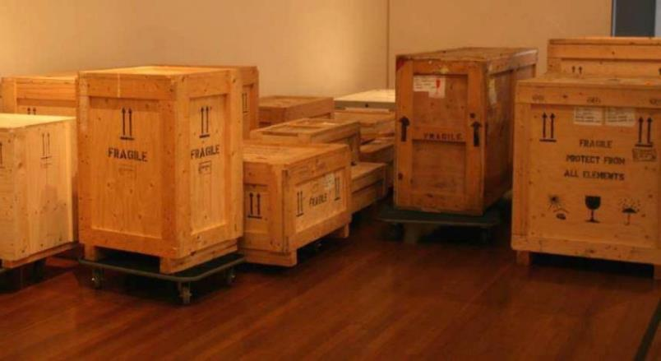
Preventative Conservation: Transport
Crates
Ensure good protection for fragile artworks during transportation and storage.
Notes:
These specially made crates are for the transportation of artworks between galleries and storage facilities.
The hardest wearing crates are made of wood, and for gallery storage some are made of acid-free cardboard.
Crates often have individually made supports that cradle the artwork to keep it secure during transportation.
The crates pictured have stamps to say they’re fragile, and arrows pointing up, to ensure they are kept the right way up.
Some artworks are so valuable, they even need to be transported on refrigerated trucks or planes to ensure a consistent temperature.
_____________________________________
Image credit: Travelling exhibitions and sculptures often arrive in crates and are moved using wheeled “dollies”.

Slide 35
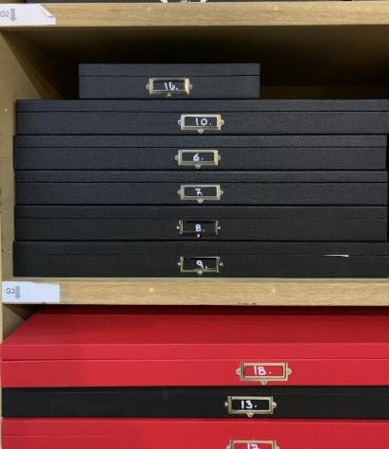
Preventative Conservation: Storage
Solander boxes are made for storing flat artworks made of paper:
Photography
Drawing
Collage
Works on paper can be exhibited for one month, then stored for 3 months.
Notes:
Artworks on paper, such as photographs, collages and drawings are stored in Solander boxes, as they are particularly susceptible to fibre breakdown from cumulative light damage.
Solander boxes are custom made and have especially made seals that keep the contents in complete darkness, air-tight, dust-free and safe from insects and other hazards.
Works on paper are removed from their frames then stacked neatly in their cardboard mount within the Solander box.
Works on paper are generally rested between display. An artwork may be displayed for one month, then placed in storage for three months, before it can be exhibited again.
_____________________________________
Image credit: Solander boxes stacked on storage shelving.

Slide 36
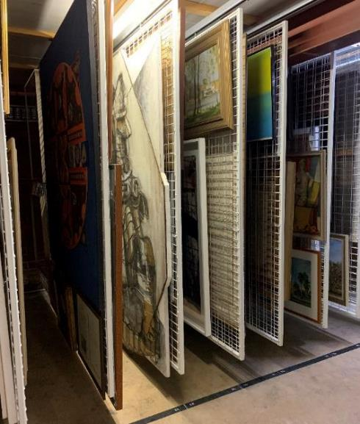
Preventative Conservation: Storage
Notes:
Paintings are stored, to hang on metal racks when not on display. These storerooms tend to be kept in darkness so light cannot damage them. It also means the works are kept off the floor and away from spills that may occur.
_____________________________________
Image credit: Mildura Arts Centre Collection storage racks

Slide 37
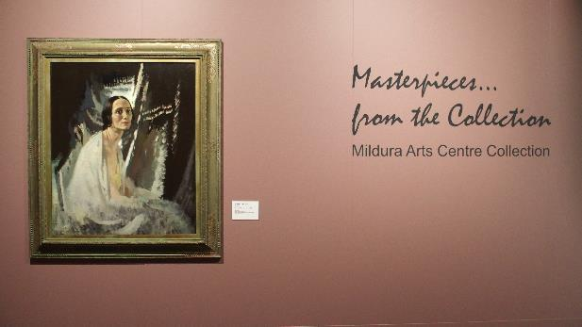
Remedial or Restorative Conservation
When steps are taken to repair an artwork and restore it to its original appearance.
Damage could be from poor handling or from aging.
Any repair works must be minimal, to maintain as much of the original work as possible and able to be undone.
Curator liaises with a conservator.
Notes:
Remedial or Restorative Conversation occurs when steps are taken to repair a damaged artwork, to restore it to its original appearance.
This could be damage, such as a tear or break that has occurred from poor handling or deterioration from aging.
It is important that any steps taken to repair or restore an artwork can be undone, so that if a better method becomes available, or it is decided the damage is part of the story of the object, the restoration can be reversed.
This restoration work is completed by a conservator, which is a very specialised role. Conservators often work in specialised areas, for example, painting, ceramics, digital, or plastics. They work closely with the curator.
_____________________________________
Image credit: Masterpieces from the Collection: Mildura Arts Centre Collection (installation view). Mildura Arts Centre upper galleries.
Artwork credit: Sir William Newenham Montague Orpen RA (1878-1931), Portrait of Anna Pavlova, 1920. Oil on canvas. Senator R.D Elliott Bequest, presented to the City of Mildura by Mrs Hilda Elliott, 1956. M13.

Slide 38
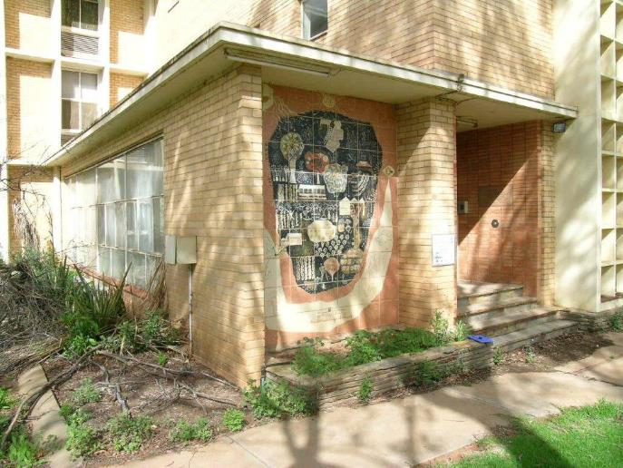
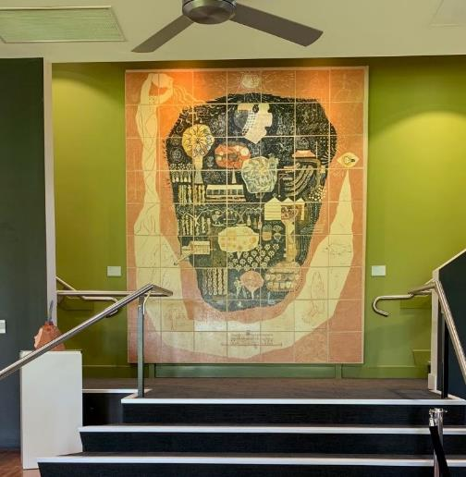
Remedial or Restorative Conservation
Douglas Annand Mural
Notes:
Douglas Annand Mural, 1953
ceramic tiles, 3.1m x 2.5m
This public artwork was created in 1953 and originally located at Marie Yapp Nurses’ Home in Mildura. It is one of the earliest site‑specific, modernist, ceramic murals in Australia, significant for its references to the river, Indigenous environs and the Mildura area.
In 2007 the Nurses’ Home was marked for demolition, so the mural was carefully removed and sent for conservation. Each tile was carefully cleaned and conserved before being reinstated within Mildura Arts Centre foyer using traditional ceramics methods.
_____________________________________
Image credits: Left - Douglas Annand Mural installed at Marie Yapp Nurses’ Home prior to its removal, 2007.
Right - Douglas Annand Mural installed in Mildura Arts Centre Foyer, 2020.

Slide 39
Marketing and Promotion
Case study: Mildura Arts Centre
Notes:
It is no good putting on an exhibition if nobody visits. Curators and artists work closely with a graphic designer and marketing team to develop printed and digital material to promote the exhibition.
_____________________________________

Slide 40

Marketing Mildura Arts Centre Exhibitions
Graphic designer and marketing staff work with the curator and artist
Featured artworks are attractive, inoffensive and must fit the format of the printed material.
Promotional material can include, exhibition opening invitations, street signage, web banners, posters, flyers, exhibition guides, post cards, e-news email bulletins, social media, gallery website, seasonal guides, and arts magazines.
Notes:
Featured artworks are chosen to best represent the exhibitions and must have general appeal (not offensive).
The format, size and detailing must also be suitable, and copyright permissions sought. For example, some artists don’t allow their work to cropped.
Promotional material includes, exhibition opening invitations, street signage, web banners, posters, flyers, exhibition guides, post cards, e-news email bulletins, social media, gallery website, seasonal guides, and arts magazines like ‘Art Guide’, ‘Art Almanac’ and ‘Mildura Living’.
The marketing team will also write press releases to promote the exhibition to the local newspapers such as ‘Sunraysia Daily’, television and radio stations, so they publish stories about the exhibition.
Public programs such as artist and curator talks are scheduled to enhance interpretation and engagement. Diverse programs are created for schools and the general public that will attract visitors.
Art galleries are important economic drivers in communities as they attract tourists and enhance local business outcomes.
_____________________________________
Image credit: A-frame billboard corner of Eighth Street and Lime Avenue, Mildura. Billboard design by Saunders Design Group.

Slide 41

Notes:
DISCUSSION: If you were marketing an art exhibition, what methods of promotion could you use? What if your budget was less that $200? How would that change your approach?
_____________________________________
Image credit: MAC Facebook page screenshot 28 March 2020.

Slide 42
Mildura Arts Centre
Notes:
To learn more about Mildura Arts Centre and its programs visit milduraartscentre.com.au
_____________________________________
Image credit: Mildura Arts Centre, view from lawns looking towards main entrance.

